Slide 1
Professional Communication uhu003.blogspot.com

Slide 2
Communication
The word communication is derived from the Latin word “communis” which means common.
We spend most of our life communicating.
Therefore it needs proper understanding and application for sophistication of our activities.
Communication is meeting of minds, for transfer of ideas.

Slide 3
A definition of communication
Communication is a process of transfer, exchange, sharing of ideas, thoughts, feelings etc in such a way that the mental picture envisioned by the sender is the same as that perceived by the receiver.

Slide 4
Characteristics of communication
Two way process
Continuous
Essential
Has an objective or a purpose
Pervasive across all walks of life.

Slide 5
The Communication Process
Feedback
Decoding
Receiver
Source
Encoding
Channel
Message
Message
Message
Message
Message

Slide 6
Importance of Feedback
We may say that communication has occurred only when the message has been understood.
Understanding occurs in the mind of the receiver.
Feedback is critical to ensure that accurate understanding of the message has occurred.

Slide 7
Constructive and Destructive feedback
Constructive
tries to improve the current situation.
positive and correct tone of message.
e.g-The design needs to be reviewed from the practical angle and minute issues.
Destructive
Derogatory
Hurting
Harmful
e.g-This design is absolutely useless and impractical and lacks attention to little details.

Slide 8
Feedback
Some points while giving feedback:
Avoid giving bitter feedback directly
Look at areas that can be improved upon
Do not highlight the negative areas too much
Do not settle your personal scores while giving feedback
Explain your limitations
Take time to give feedback

Slide 9
Avoid criticising directly
Your performance at work has been very poor this year.
vs
Your performance needs improvement from this year.

Slide 10
Don’t highlight negative areas too much!
You have not been able to achieve anything in the last quarter. We have paid your salary, without getting any benefits from you.
Your contribution in the last quarter should have been better, and the company is looking for better performance from you.

Slide 11
Do not settle your personal scores
You had told me that this organization is not for losers but for performers. Now that I am leaving the organization, I am saying that this organization wants to keep only the losers and not the performers.
The organization should do a relook objectively at its policies of retaining the performers.

Slide 12
Feedback
Some points while receiving feedback:
Listen to the person and be more open to receive feedback.
Avoid giving justifications as much as possible.
Focus on the key areas where you can improve.
You may choose to ignore some of the feedback given.

Slide 13
Feedback
Some ways to be more comfortable and confident when receiving feedback:
Be open-minded
Look for the lesson
Ask clarifying questions
Ask for their advice
Suspend judgment: depersonalize it
Say thank you

Slide 14
Communication Patterns-Underlying theories
JOHARI WINDOW
Analyses self in relation to others.
Helps increase knowledge about receiver and sender.
Improves interpersonal communication through feedback and disclosure.
TRANSACTIONAL ANALYSIS
Provides explanation of communication patterns.
Helps to recognize Ego states and modify transactions.
Increases successful communication

Slide 15
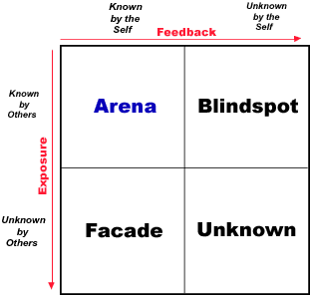

Slide 16
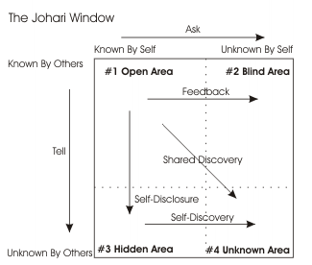

Slide 17
Key Points:
In most cases, the aim in groups should be to develop the Open Area for every person.
Working in this area with others usually allows for enhanced individual and team effectiveness and productivity. The Open Area is the ‘space’ where good communications and cooperation occur, free from confusion, conflict and misunderstanding.
Self-disclosure is the process by which people expand the Open Area vertically. Feedback is the process by which people expand this area horizontally.
By encouraging healthy self-disclosure and sensitive feedback, you can build a stronger and more effective team.

Slide 18
Transactional analysis (Eric Berne – 1910-1970)
It is about analyzing and understanding human communication.
Based on psychoanalytic traditions of Sigmund Freud.
The basic premise is that human personality is constructed of three ego-states.
Child ego state
Adult ego state
Parent ego state
The ego states can be predicted as behavioral states (verbal and non-verbal). Typical behaviors are specific to each ego-state.
18

Slide 19
Transactional analysis
According to Berne, an ego state is a consistent pattern of feeling and experience directly related to a corresponding consistent pattern of behavior.
19

Slide 20
Transactional analysis
The parent is the ego state that contains the external events that were imposed on people in the first five years of their life. These are constructs that are imposed on the child.
Examples would be
'Don't talk to strangers,'
'Always hold a grown-up's hand when you cross the street,' or
'Don't touch a hot stove.'
20

Slide 21
Transactional analysis
The child is the ego state that contains the feelings and emotions related to the external events that were imposed on a person in the first five years of life. These feelings or emotions are replayed in the person's mind when the corresponding external event is recalled.
Examples would be
'Being approached by a strange person makes me feel nervous,'
'I feel safe when I hold someone's hand,' or
'I am scared of being burned.'
21

Slide 22
Transactional analysis
The last ego state is the adult. The adult is the ego state that evaluates what is really going on and makes independent decisions about the world. This ego state begins forming as soon as we gain the ability to control aspects of our environment. It allows a person to compare what they are told about the world with what they feel and experience.
Let's use the hot stove as an example. The adult is told by the parent not to touch a hot stove and recognizes that the child's fear of being burned is reasonable. Therefore, the adult determines to use caution when it's necessary to use a hot stove.
22

Slide 23
Transactional analysis
Parent
There are two forms of Parent we can play.
The Nurturing Parent is caring and concerned and often may appear as a mother-figure (though men can play it too). They seek to keep the Child contented, offering a safe haven and unconditional love to calm the Child's troubles.
The Controlling (or Critical) Parent, on the other hand, tries to make the Child do as the parent wants them to do, perhaps transferring values or beliefs or helping the Child to understand and live in society.
Parent is our TAUGHT concept of life.
23

Slide 24
Transactional analysis
Adult
the Adult in us is the 'grown up' rational person who talks reasonably and assertively,
neither trying to control nor reacting aggressively towards others.
The Adult is comfortable with themself and is the THOUGHT concept of life..
24

Slide 25
Transactional analysis
Child our FELT concept of life.
Free Child: The natural child in all of us.
The Adaptive Child reacts to the world around them, either changing themselves to fit in or rebelling against the forces they feel.
25

Slide 26
Human communication
In transactional analysis the basic unit of communication is termed as stroke.
These strokes may be-
Positive
Negative
Stroke is a “unit of human recognition”.
A stroke can be a look, a nod, a smile, a spoken word, a touch. Any time one human being does something to recognize another human being, that is a stroke. Babies need strokes to survive.
Strokes can be positive or negative. Most of us like positive strokes better than negative ones.

Slide 27
Transactions
Transaction is defined as the phenomenon of change of strokes.
As exchange is fundamental to daily human life, the exchange of strokes leading towards different transactions are fundamental to human communications.

Slide 28
Human Interaction Analysis
A transaction = any interaction or communication between 2 people
People send and receive messages out of and into their different ego states
How people say something (what others hear?) is just as important as what is said
Types of communication, interactions
Complementary
Crossed
Ulterior

Slide 29
Complementary ‘Transactions’
Interactions, responses, actions regarded as appropriate and expected from another person.
Parallel communication arrows, communication continues.
Example 1: #1 What time do you have?
#2 I’ve got 11:15.
P
P
A
A
C
C

Slide 30
Complementary ‘Transactions’ cont’d
Example 2:
#1 You’re late again!
P
P
#2 I’m sorry. It won’t happen again.
A
A
C
C

Slide 31
Crossed ‘Transactions’
Interactions, responses, actions NOT regarded as appropriate or expected from another person.
Crossed communication arrows, communication breakdown.
Example 1 #1 What time do you have?
#2 There’s a clock on the wall, why don’t you figure it out yourself?
P
P
A
A
C
C

Slide 32
Crossed ‘Transactions’ cont’d
Example 2 #1 You’re late again!
#2 Yeah, I know, I had a flat tire.
P
P
A
A
C
C

Slide 33
Ulterior ‘Transactions’
Ulterior – existing beyond obvious
Overt (directly observable) and
Covert (more at psychological level) type messages conveyed simultaneously
The hidden messages may be misinterpreted.
P
P
Interactions, responses, actions which are different from those explicitly stated
Example#1 “This car is too racy for you!”
Social level
A
A
Psychological level
C
C

Slide 34
Seven C’s of Effective Communication
Completeness
Conciseness
Consideration
Concreteness
Creativity
Courtesy
Correctness

Slide 35
Completeness
Five W’s
One way to make your message complete is to answer the five W’s.
WHO?
WHAT?
WHEN?
WHERE?
WHY?
The five question method is useful when you write requests, announcements, or other informative messages.
For instance, to order (request) merchandise, make clear WHAT you want, WHEN u need it, WHERE it is to be sent.

Slide 36
Who, what, when, where, why.
Hi everyone,
I just wanted to send you all a reminder about the meeting we're having tomorrow!
See you then,
Mukesh
Hi everyone,
I just wanted to remind you about tomorrow's meeting on the new telecommuting policies. The meeting will be at 10:00 a.m. in the second-level conference room. Please let me know if you can't attend.
See you then,
Mukesh

Slide 37
Completeness
I did not hear from your company, after complaining to the customer care twice.
vs
I had registered a complaint with the customer care (reference number/ complaint numbers 12 and 23) on 16th February 2017, and 23rd February 2017, respectively. Can you please let me know the status of the complaint?

Slide 38
Completeness
I will reach Delhi airport tomorrow.
vs
I will reach Delhi international airport by Jet Airways at 8 a.m. on 25th February 2017.

Slide 39
2) Conciseness
Conciseness means “convey the message by using fewest words”.
“Conciseness is the prerequisite to effective business communication.”
A concise message saves the time and expenses for both the parties.

Slide 40
How To achieve conciseness ?
For achieving conciseness you have to consider the following.
Avoid wordy expression
Include only relevant material
Avoid unnecessary repetition.

Slide 41
Avoid Wordy Expression
Last financial year, the room sales for our hotel were average, and the figures went up merely by a small percentage. One may list a number of reasons for this performance. Some of the important factors can be the quality of marketing activities undertaken by our company. Moreover, the recession had its impact.
or
The financial year 2016-17 saw a mere 5 percent growth in the sale of rooms, compared to the last financial year. The major reason for this average performance was our inability to tap into the corporate space. The recessionarry trend in the market was another reason.

Slide 42
Avoid Wordy Expression
We are pleased to inform you that the corrected bill that you have sent us looks better than the previous one.
vs
We have received your corrected bill.
Please refer to the email sent by Rahul and you are expected to complete the assignment and send it across by today evening.
vs
With reference to Rahul’s email dated 5th August 2017, please submit your assignments by 5 this evening.

Slide 43
Avoid Wordy Expression
The revenues were up this year by a significant margin.
vs
The revenues were up by 40%.
We deeply regret the fact that the prices are up.
vs
We regret the increase in prices.

Slide 44
Avoid Wordy Expression
E.g. Wordy:- at this time.
Instead of “at this time” you can just use only a concise word:- NOW ,
Always try to use “ To the point Approach” in business scenario perspective.

Slide 45
Avoid filler words/ phrases
"for instance,“
"you see,"
"definitely,"
"kind of,"
"literally,"
"basically,"
"I mean."

Slide 46
Include only relevant information
Always try to provide only relevant information to the receiver of the message.
Lets say one of your customer requested information
About list of clients of the company
in reply you should provide simply list of clients at the panel of your company.
No need to provide detailed business information about client at all.

Slide 47
Avoid unnecessary repetition
Sometimes repetition is necessary for focusing some special issue.
But when the same thing is said two or three times without a valid reason, the message become wordy and boring.
That’s why we should try to avoid unnecessary repetition.

Slide 48
Some ways to eliminate unnecessary words
Use shorter name after you have mentioned the long once. e.g.
Spectrum communications Private limited use Spectrum.
Use abbreviations e.g.
Instead of World Trade Organization use WTO or You can use IT for Information Technology.( keeping in views that receiver knows about these terms)

Slide 49
3) Consideration
Consideration means – To consider the receiver’s Interest/Intention.
It is very important in effective communication while writing a message you should always keep in mind your target group.

Slide 50
Three specific ways to indicate consideration
i-Focus on “you” instead of “I” or “We”
ii-Show audience benefit or interest of the receiver
iii-Emphasize positive, pleasant facts.

Slide 51
We attitude
We are delighted to announce that we will extend shopping hours to make shopping more enjoyable and longer...
You attitude
“You will be able to shop in the evening with the extended hours.”

Slide 52
4) Concreteness
It means that message should be specific instead of general. Misunderstanding of words creates problems for both parties (sender and receiver).
When you talk to your client always use facts and figures instead of generic or irrelevant information.

Slide 53
General
He is very intelligent student of class and stood first in the class.
vs
Concrete
Rahul’s GPA in B.Tech. Electrical Engineering 2014 even semester was 3.95/4.0; he stood first in his class.

Slide 54
Creativity
Message able to hold attention of receiver.
Use of images, charts etc creatively.
Expression that is non-routine and out of the box.

Slide 55
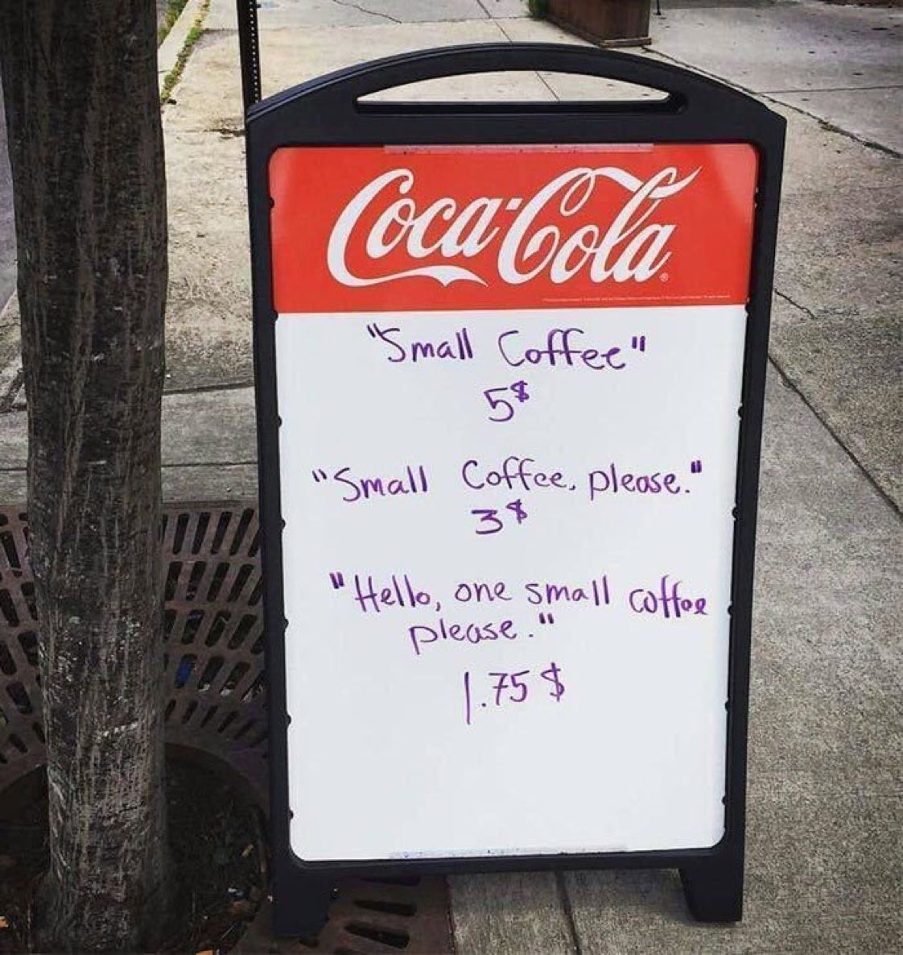
Courtesy

Slide 56
Courtesy
Knowing your audience allows you to use statements of courtesy; be aware of your message receiver.
Courtesy stems from a sincere you-attitude.
Be genuinely courteous. It is not merely politeness with mechanical insertions of “please” and “Thank you” .

Slide 57
Email 1
Ramesh,
I wanted to let you know that I don't appreciate how your team always monopolizes the discussion at our weekly meetings. I have a lot of projects, and I really need time to get my team's progress discussed as well. So far, thanks to your department, I haven't been able to do that. Can you make sure they make time for me and my team next week?
Thanks,
Suresh

Slide 58
Email 2
Hi Ramesh,
I wanted to write you a quick note to ask a favor. During our weekly meetings, your team does an excellent job of highlighting their progress. But this uses some of the time available for my team to highlight theirs. I'd really appreciate it if you could give my team a little extra time each week to fully cover their progress reports.
Thanks so much, and please let me know if there's anything I can do for you!
Best,
Suresh

Slide 59
How to generate a Courteous Tone ?
The following are suggestions for generating a courteous tone:
Be tactful, thoughtful and sincerely appreciative.
Use expressions that show respect for the others.
Choose nondiscriminatory expressions.

Slide 60
Tactless, Blunt | More Tactful
Stupid letter; I can’t understand. | Could you please explain it once again ..?
Its your fault, you did not properly read my latest email. | Let me try if I can change my wording to make you understand better.

Slide 61
Never use offensive words
This report is useless
Your behaviour was irresponsible.
Your laziness towards work has created all this mishap.
This report needs more clarity.
You will need to behave more professionally.
A little more focus on work would have been more productive.

Slide 62
Choose nondiscriminatory expressions
Use gender-neutral words
Neutralise any reference to gender, like using "they" as a third person singular pronoun instead of "he" or "she”
or instead of using ‘he’, use he/she or s/he
Use gender-neutral words like chairperson (instead of chairman) or police officer (instead of policeman)
Use appropriate disability wording
(respectful disability language is important)
Do not mention age

Slide 63
When talking about disability
Do not refer to a person's disability unless it is relevant. For example, don’t ask “What’s wrong with you?” or refer to the “girl in the wheelchair”.
Use "disability" rather than "handicap" to refer to a person's disability. When talking about or referring to parking spaces or bathroom stalls used by people with disabilities say "accessible" or “disabled” parking or “accessible” or “disabled” access stall.
Never use "cripple/crippled" or “mental” when talking about disability in general or the person.
Don't portray people with disabilities as overly courageous, brave, special, or superhuman. This makes it sound like it is unusual for people with disabilities to have talents, skills or to live life like everyone else.
Don't use "normal" to describe people who don't have disabilities. It is better to say "people without disabilities” if necessary to make comparisons.

Slide 64
Words to use and avoid regarding disabled
AVOID:
Crazy, insane • Cripple, lame • Handicapped, physically challenged, special • Retarded, slow • Wheelchair-bound• Brain-damaged • Dwarf, midget, little person • Invalid, deaf, dumb, deaf-mute • Deformed
USE:
Psychiatrically disabled • Disabled • Cognitively disabled • People with disabilities • Visually impaired, Hearing-impaired • Wheelchair user • Someone of short stature • Developmentally disabled • Learning disabled

Slide 65
7) Correctness
At the core of correctness is proper grammar, punctuation and spelling.
However, message must be perfect grammatically and mechanically.
. The term correctness, as applied to business messages also means three characteristics
Use the right level of language
Check the accuracy of figures, facts and words
Maintain acceptable writing mechanics

Slide 66
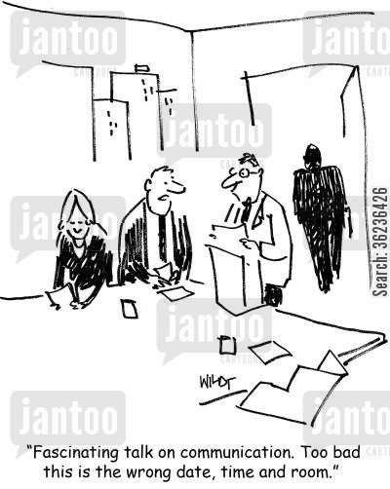
Correctness

Slide 67
Use the right Level of Language
Three levels of language
Formal
Informal
Substandard.

Slide 68
Formal and Informal Words
Formal writing is often associated with scholarly writing: doctoral dissertations, scholarly, legal documents, top-level government agreements and other material where formality is demanded.
Informal writing is more characteristic of business writing. Here you use words that are short, well-known and conversational as in this comparison list:
More Formal less formal
Participate Join
Endeavor try
Ascertain find out
Utilize use
Interrogate question

Slide 69
Substandard Language
Avoid substandard language. Using correct words, incorrect grammar, faulty pronunciation all suggest an inability to use good English. Some examples follow:
Substandard More Acceptable
Ain’t isn’t,aren’t
Can’t hardly can hardly
Aim to proving aim to prove
Desirous to desirous of
Stoled stolen

Slide 70
Facts and Figures Accuracy
Check Accuracy of Facts, Figures and words
It is impossible to convey meaning precisely, through words, from the head of the sender to a receiver. Our goal is to be as precise as possible, which means checking and double-checking to ensure that the figures, facts and words you use are correct.
Figures and facts
Verify your statistical data
Double-check your totals
Avoid guessing at laws that have an impact on you, the sender and your organization.
Have someone else read your message if the topic involves data.
Determine whether a “fact” has changed over time

Slide 71
Proper Use of Confusing Words!
Our Language (Any) is constantly changing. In fact,even dictionaries can not keep up with rapid change in our language. the following words often confusing in usage:
A, An use a before consonants and consonants sounds or a long ” u” sound. Use an before vowels.
Accept, except accept is a verb and means to receive. except is a verb or a preposition and relates to omitting or leaving out.
Anxious, eager Anxious implies worry, eager conveys keen desire

Slide 72
Proper Use of Confusing Words!
Adopt/ adapt
Advise/ advice
Affect/ effect
Allusion/ illusion
Principal/ principle
Compliment/ complement
Criterion/ criteria
Phenomenon/ phenomena
Fortunate/ fortuitous
Idol/ idle
Desert/dessert

Slide 73
Challenges while sending and receiving a message
Unclear ideas
Wrong or inappropriate medium
Noises or breakdowns during communication
Message ignored or missed due to information clutter
Meaning of messages not interpreted the way they were meant

Slide 74
Challenges while sending a message
Unclear ideas
Many messages to be addressed.
Multiple thoughts in the same message.
SOLUTION:
- Stay focused on your message and the reason for sending it (purpose of sending the message).
- Communicate different pieces of information with separate messages.
- Do not combine messages and confuse the audience.

Slide 75
Challenges while sending a message
Wrong or inappropriate medium
Use suitable media
Each medium has its uses and shortcomings.
Check requirements: type of message, speed, documentation
Noises or breakdowns during communication
- Barriers

Slide 76
Challenges while receiving a message
Message ignored or missed due to information clutter
Solution: target the right audience
Message should be easy to grasp
Meaning of messages not interpreted the way they were meant
Be objective and concrete

Slide 77
Barriers to Communication
Sender-oriented barriers
Linguistic barriers
Cross cultural barriers
Physical barriers
Psychological barriers
Emotional barriers
Perceptual barriers

Slide 78
Framing a message!
You have two sides, one out in the field and one in. Each man that's in the side that's in goes out, and when he's out he comes in and the next man goes in until he's out. When they are all out, the side that's out comes in and the side that's been in goes out and tries to get those coming in, out. Sometimes you get men still in and not out.
When a man goes out to go in, the men who are out try to get him out, and when he is out he goes in and the next man in goes out and goes in. There are two men called umpires who stay out all the time and they decide when the men who are in are out. When both sides have been in and all the men have been out, and both sides have been out twice after all the men have been in, including those who are not out, that is the end of the game.

Slide 79
Language and semantics
Different languages, different dialects
Semantics: the study of meanings in language
Lie, date, set, Braces
Rain, rein, reign / quite, quiet/ no, know.
Punctuation
Godisnowhere
A woman, without her man, is nothing.
A woman: without her, man is nothing.

Slide 80


Slide 81
Cross cultural barriers
Difference in approaches to communicate due to cultural nuances.
‘soon’,
‘eye contact’,
time,
‘swastika’ ,
stereotypes,
ethno-centricism

Slide 82


Slide 83
Physical barriers
Noise
Poor acoustics
People chatting
Physical/ mental/ written/ visual noise
Filters
Blockages that prevent message from being received.
Junk/ spam filters
Failure of communication channels
Distance e.g. staff sitting in different buildings
Gender, Age

Slide 84
Gender differences
Women talk about other people. Men talk about tangible things like business, sports, food and drinks.
Women ask questions to gain an understanding. Men talk to give information rather than asking questions.
Women are more likely to talk to other women when a problem or conflict arises. Men are often known for dealing with problems or issues internally.
Women focus on feelings, senses and meaning. They rely on their intuition to find answers. Men focus on facts, reason and logic. They find answers by analyzing and figuring things out.
A disagreement between women affects many aspects of their relationship and may take a long time to resolve. Men can argue or disagree and then move on quickly from the conflict.

Slide 85
Psychological barriers
Lack of attention
Distrust
A closed mind
Being judgmental

Slide 86
Emotional barriers
Anger - Anger can affect the way your brain processes information given to you. For example, angry people have difficulty processing logical statements, limiting their ability to accept explanations and solutions offered by others
Pride - The need to be right all the time will not only annoy others, it can shut down effective communication. For example, you might focus only on your perspective, or you might come up with ways to shoot down other people before you even listen to their points.
Anxiousness - Anxiety has a negative impact on the part of your brain that manages creativity and communication skills. For example, your constant worries can hinder your ability to concentrate on the information you are giving or receiving.

